Slide 1
SQL Introduction

Slide 2
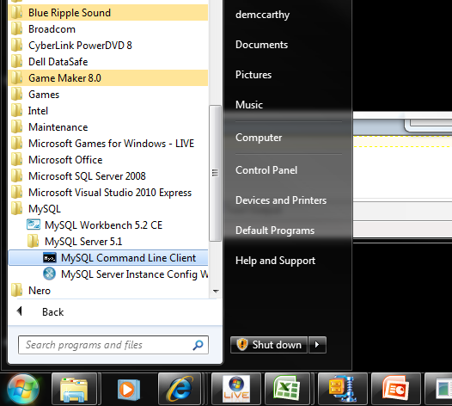
Open up the MySQL command line client
When prompted the password is “root”

Slide 3
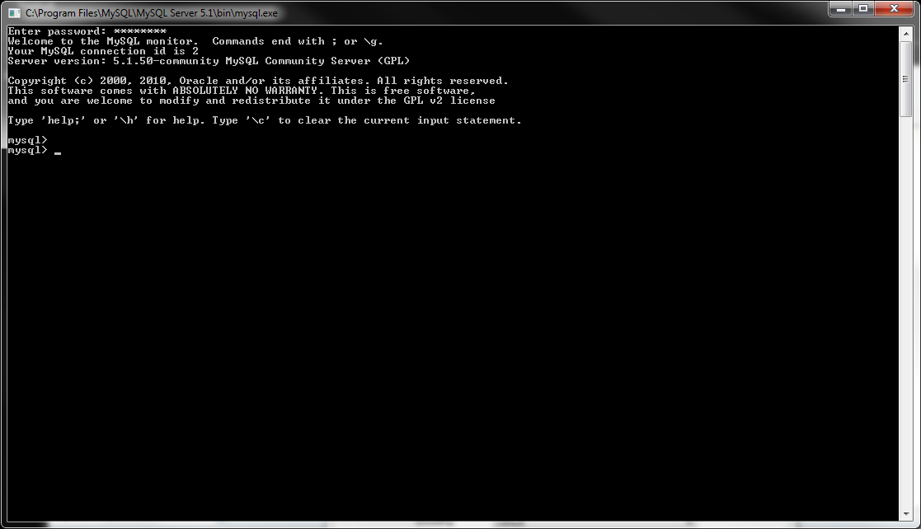
The client will look like

Slide 4
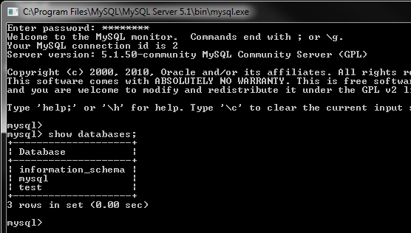
Getting started
Initial commands:
  To see what databases are in the system type:
    show databases;

Slide 5
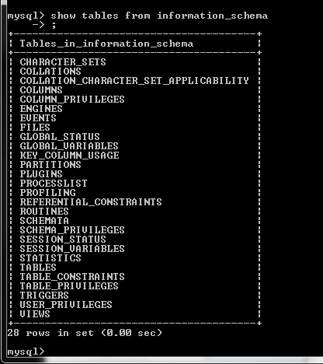
More commands
To show the tables within the information_schema database type:
  show tables from information_schema;

Slide 6
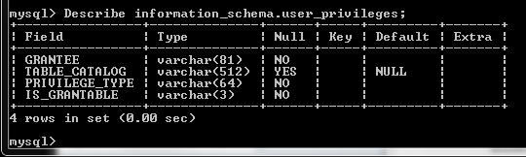
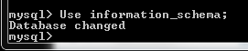
More commands
To view the meta data (data about the data)
  describe information_schema.user_privileges;
Its tedious writing the database name every time, so instead we switch to that database
  use information_schema;

Slide 7
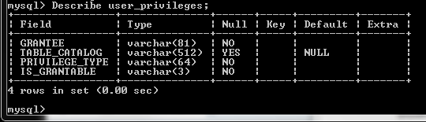
More commands
Now since we are in the selected database, we can access the table directly:
  describe user_privileges;

Slide 8
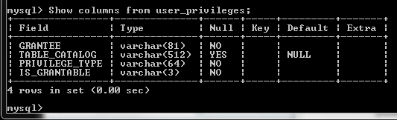
More Commands
Another way to do this
  show columns from user_privileges;

Slide 9
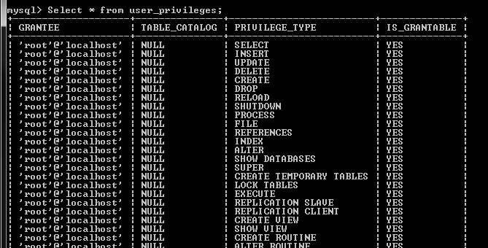
Introduction to select command
To view the contents of the table, i.e. All of the records it holds.
  select * from user_privileges;

Slide 10
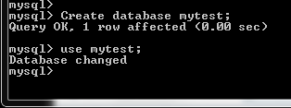
Create a database
To create a database called “myTest”
  create database mytest;
Make sure to switch to the newly created database after you create it.
  use mytest;

Slide 11
Creating a table
To create a table to store 4 pieces of info
  ID
  First name
  Last name
  Gender
  create table my_info (
  id integer not null,
  first_name char(12),
  last_name char (20),
  gender char(1));

Slide 12
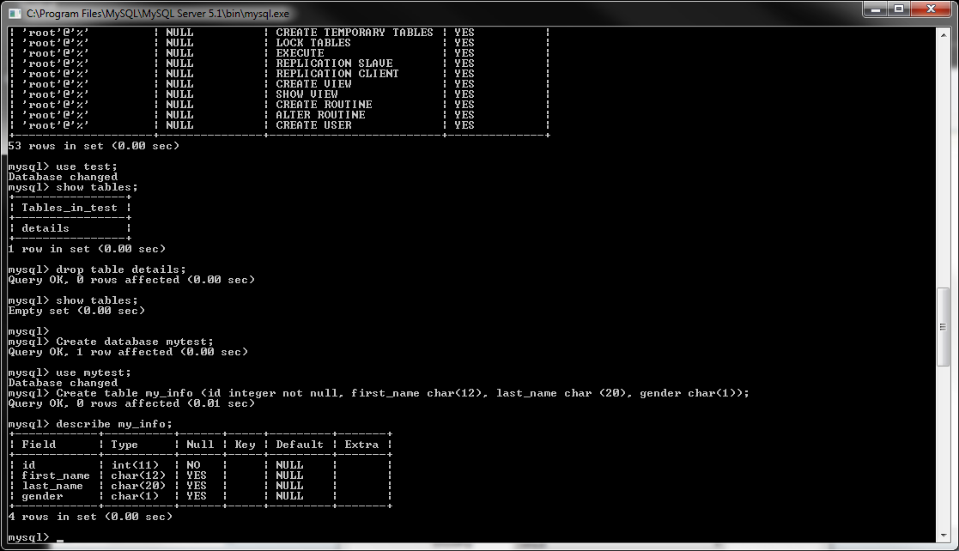
Your created table

Slide 13
If you made a mistake
You can delete the table if you made a mistake, note that this will remove all data in the table.
  drop table my_info;

Slide 14
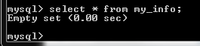
Any data?
Check to see if there is any data in your table
Can you remember the command?

Slide 15
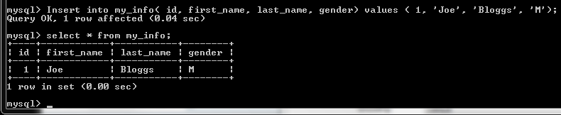
Adding data
Next we need to put some data into the table
  insert into my_info( id, first_name, last_name, gender) values ( 1, ‘Joe’, ‘Bloggs’, ‘M’);

Slide 16
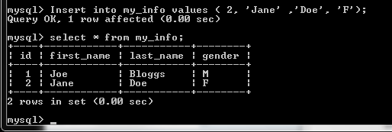
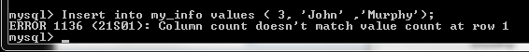
Or a quick way
  insert into my_info values ( 2, ‘Jane’ ,’Doe’, ‘F’);
What would happen if you left a column out?
  insert into my_info values ( 3, ‘John’ ,’Murphy’);

Slide 17
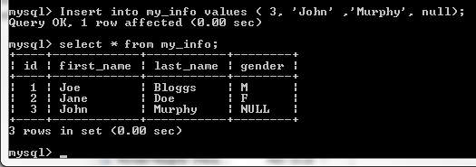
Adding data
You would have to use
  insert into my_info values ( 3, ‘John’ ,’Murphy’, null);

Slide 18
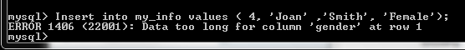
Adding Data
What would happen if you inserted too long of a string for gender
  insert into my_info values ( 4, ‘Joan’ ,’Smith’, ‘Female’);
Would have to use
  insert into my_info values ( 4, ‘Joan’ ,’Smith’, ‘F’);

Slide 19
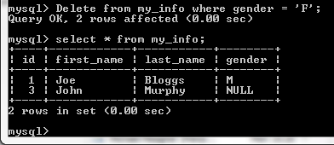
Deleting records
To delete all of the females;
  delete from my_info where gender = ‘F’;

Slide 20
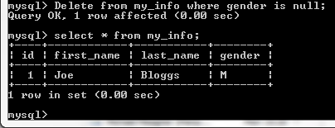
Deleting using nulls
Deleting using nulls is a special case
  delete from my_info where gender is null;

Slide 21
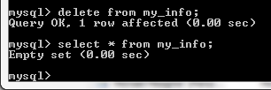
Delete entire table contents
To delete the entire contents of the table but leave the table intact
  delete from my_info;

